Slide 1

Northeastern University - Seattle
CS6650 Building Scalable Distributed Systems
Vishal Rajpal

Slide 2
Week 7 – Serverless Computing
Topics we will cover today:
Why Serverless Computing?
Google App Engine Overview
Experimental Results
AWS Lambda Overview

Slide 3
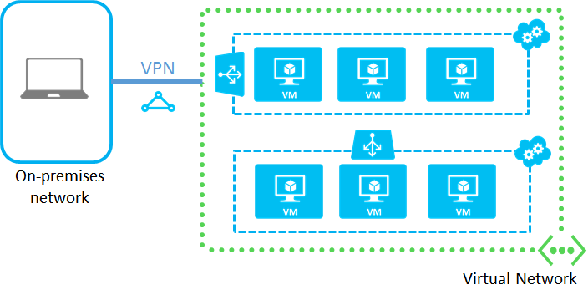
Why Serverless Computing?
Notes:
Scalable systems experience widely varying patterns of usage.
For some applications load may be high during high business hours and low or nonexistent during nonbusiness hours.
Other applications such as online concert ticket sales system might have low background traffic most of the time except during release of tickets for a major show.
Load balancing is one approach, another approach is serverless computing.

Slide 4
Why Serverless Computing?
VM Based Processing
Provision and configure VMs
Choose instance type
Install software
Instance monitoring
On-going maintenance
As load grows
Load balancing
Increase database capacities
Application monitoring
Scale down during low usage periods to save costs
Notes:
Traditionally cloud applications have been deployed on a infrastructure as a service utilizing virtual machines.
You pay for the resources you deploy regardless of how highly utilized they are.
If load increases elastic applications can spin up new VMs to increase capacity typically using cloud provided scaling services.
Your costs are proportional to the type of VMs you choose, the duration they are deployed for and the amount of data the application stores and transmits.

Slide 5
Why Serverless Computing?
VM Based Cloud Apps Costs
On going monitoring and management
System Administration
Potentially unused resources
Serverless Computing
Aka Function as a Service (FaaS)
No VMs to provision and manage
No costs if not running code
Auto scaling up and down
Notes:
Major cloud providers offer an alternative to explicitly provisioning virtual processing resources.
Known as serverless platforms, they do not require any compute resources to be statistically provisioned.
Using technologies such as AWS Lambda or Google App Engine the application code is loaded and executed on demand when requests arrive.
If there are no active requests, there are essentially no resources in use and no charges to meet.
Serverless platforms also manage autoscaling for you.
As simultaenous requests arrive, additional processing capacity is created to handle requests and ideally provide consistently low response times.
When request loads drop, additional processing capacity is decommissioned and no charges are incurred.

Slide 6
Why Serverless Computing?
FaaS Platforms
Examples
AWS Lambda
Google App Engine
Azure Functions
Upload code to deploy
Each platforms supports a variety of languages/frameworks
Auto horizontal scaling configurable for different workloads
Triggered by
HTTP Request
Events (SQS Trigger, S3 Object Update etc.)
Notes:
Every serverless platform varies in the details of its implementation.
Each platform supports a variety of mainstream programming languages and application server frameworks.
Each platform provides multiple configuration settings that can be used to balance performance, scalability and costs.

Slide 7
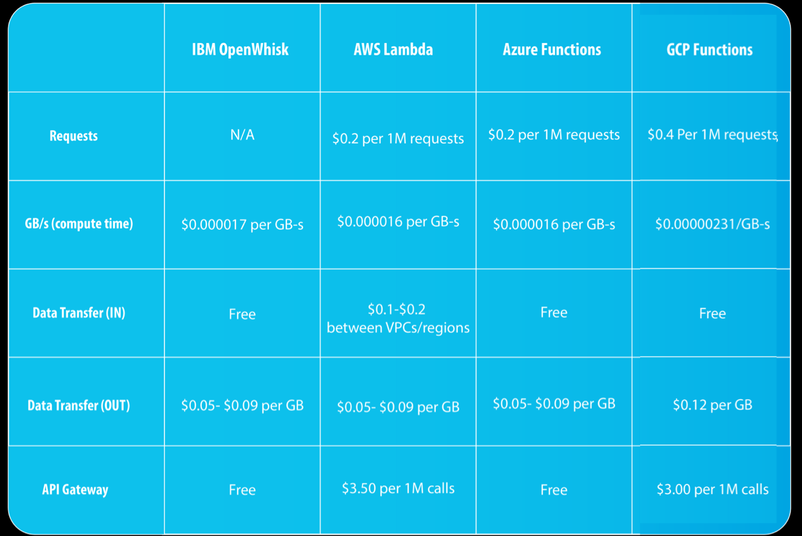
Why Serverless Computing?
Tradeoffs
Stateless - All state needs to be externalized/persistent between invocations
Execution Duration - Maximum typically 60-300 seconds by default - Configurable
Start up latency - Cold starts, Warm starts
Application/language/environment dependent
Costs - Pay per invocation of a function
Requests: around $0.2 per 1M executions across the board, across all providers
CPU & RAM: ~ $0.000067 per GB-second
Can be more expensive than VMs if utilization high
API Gateway
Notes:
In general your application needs to be
Stateless – so the serverless platform is able to make effective load balancing decisions.
Single invocations are meant to be short lived and starting new instances can be slow depending on the language and libraries used.
Each platform charges you differently for application usage.

Slide 8
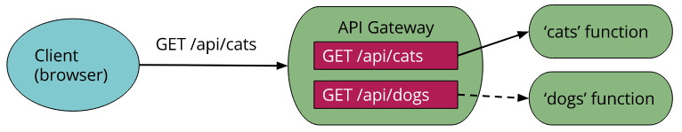
Why Serverless Computing?
API Gateway
Similar to the façade pattern
E.g. HTTP, WebSockets
Clients call Gateway and Gateway routes request to application (microservice) endpoints
Authorization
Monitoring
API version management
Other stuff input validation, traffic etc
Results sent to API Gateway and relayed to client
Cloud-provider managed server
Notes:
Lets see how API Gateway plays a role in Serverless Computing.
API Gateway is an API management tool that sits between a client and backend services.
Using API gateway you can create HTTP RESTful APIs and Websocket APIs that enable real time two-way communication applications.

Slide 9
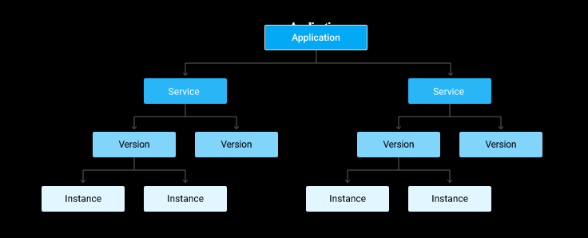
Google App Engine
GAE application comprises of one or more services
Services can be in different languages/configured differently
Service can have multiple deployed versions
Versions have multiple instances that handle requests

Slide 10
Google App Engine
App Engine Services
Equivalent to a microservice
App source code
API
Configuration
Version
Can use traffic splitting to perform A/B tests across different versions
Services/versions need unique names, eg:
http://my-version.my-service.my-project-id.appspot.com
Notes:
A/B tests are great to test two versions of a service on live traffic.

Slide 11
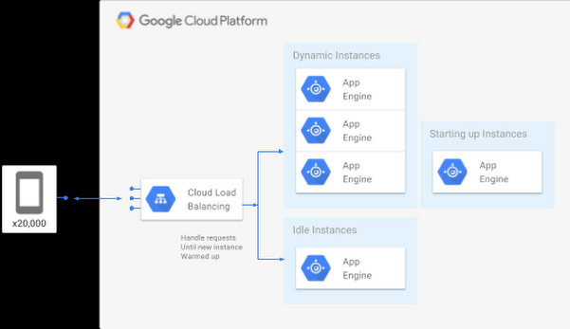
Google App Engine
Instances – Managed by GAE
Auto-scaled by default
Requires a new runtime to be deployed
JVM
Python VM
Etc
Startup costs per instance
Min/max instances
Unused instances removed (scale down)
Pay by 15 mins intervals
Instance resources (CPU/memory)
GAE Request Handling

Slide 12
Google App Engine
Auto Scaling – app.yaml
Target CPU Utilization
Default 60%
Maximum Concurrent Requests
Default 10
Target Throughput Utilization
Default 60%
Notes:
Target CPU utilization
- Sets the CPU utilization threshold above which more instances will be started to handle traffic. The range is 0.5 (50%) to 0.95 (95%). The default is 0.6 (60%).
Maximum concurrent requests
- Sets the maximum number of concurrent requests an instance can accept before the scheduler spawns a new instance. The default value is 10, and the maximum is 80. The documentation doesn’t state the minimum allowed value, but presumably 1 would define a single-threaded service.
Target throughput utilization
- Sets the throughput threshold for the number of concurrent requests after which more instances will be started to handle traffic.
- This is used in conjunction with the value specified for maximum concurrent requests to specify when a new instance is started. The range is 0.5 (50%) to 0.95 (95%). The default is 0.6 (60%). When the number of concurrent requests for an instance reaches a value equal to maximum concurrent requests value multiplied by the target throughput utilization, the scheduler tries to start a new instance.

Slide 13
AWS Lambda
Servers are stateless Lambda functions
Triggered by HTTP or events on AWS services, e.g.: S3, DynamoDB
Charged based on 100ms metering intervals
Scales automatically
Example
package example;
import com.amazonaws.services.lambda.runtime.Context;
import com.amazonaws.services.lambda.runtime.LambdaLogger;
public class Hello {
public String myHandler(int myCount, Context context) {
LambdaLogger logger = context.getLogger();
logger.log("received : " + myCount);
return String.valueOf(myCount);
}
}
Notes:
Lambda functions can be invoked by external clients over HTTP.
They can also be integrated with other AWS services.
For example these functions can be dynamically triggered when new data is written to AWS S3 bucket or an item was persisted in AWS DynamoDB.
-

Slide 14
AWS Lambda
Request arrival triggers:
Code download
Initialize function runtime
Invoke function
Initial load = Cold start
Mitigate by provisioned concurrency
Resident functions reused if inactive
Single threaded
Request burst cause new function instance loads
Notes:
When a request first arrives for the API defined by the Lambda function, Lambda downloads the code for the function, initializes a runtime environment and any instance specific initialization (e.g., creating a database connection), and finally invokes the function code handler.
This initial invocation is known as a cold start, and the time taken is dependent on the language environment selected, the size of the function code, and time taken to initialize the function. Like in GAE, lightweight languages such as Node.js and Go will typically take a few hundred milliseconds to initialize, whereas Java or .NET are heavier weight and can take a second or more.
Cold start costs can be mitigated by using provisioned concurrency. This tells Lambda to keep a minimum number of runtime instances resident and ready to process requests with no cold start overheads. The “no free lunch” principle applies of course, and charges increase based on the number of provisioned instances.
Once an API execution is completed, Lambda can use the deployed function runtime environment for subsequent requests. This means cold start costs are not incurred. However, if a burst of requests arrive simultaneously, multiple runtime instances will be initialized, one for each request. Unlike GAE, Lambda does not send multiple concurrent requests to the same runtime instance. This means all these simultaneous requests will incur additional response times due to cold start costs.

Slide 15
AWS Lambda
Function Execution
Function definition specifies runtime memory allocation
Charged by the millisecond of execution
More memory = More costs/ms.
vCPUs allocated proportionally to memory.
More memory = faster execution.
Notes:
- When you define a Lambda function, you specify the amount of memory that should be allocated to its runtime environment.

Slide 16
AWS Lambda
Trade-offs
Example:
1GB instance = 1 cost unit/millisec
2GB instance = 2 cost units/millsec
Mythical function takes:
1GB = 40 millisecs = 40 cost units
2GB = 10 millisecs = 20 cost units
Tuning can pay dividends!!
Dependent on actual function behavior
Relatively simple as only one parameter
Notes:
This situation creates a subtle trade-off between performance and costs. Let’s examine a simple example based on the costs for 1 GB and 2 GB instances mentioned above, and assume that 1 millisecond of execution on a 1 GB instance incurs 1 cost unit, and a millisecond on a 2 GB instance incurs 2 cost units.
With 1 GB of memory, I’ll assume this function executes in 40 milliseconds, thus incurring 40 cost units. With 2 GB of memory allocated, and commensurately more CPU allocation, the same function takes 10 milliseconds, meaning you part with 20 cost units from your AWS wallet. Hence your bills will be reduced by 50% and you will get 4x faster execution by allocating more memory to the function. Tuning can surely pay dividends.
This is obviously very dependent on the actual processing your Lambda function performs. Still, if your service is executed several billion times a month, this kind of somewhat nonintuitive tuning exercise may result in significant cost savings and greater scalability.
Finding this sweet spot that provides faster response times at similar or lower costs is a performance tuning experiment that can pay high dividends at scale. Lambda makes this a relatively straightforward experiment to perform as there is only one parameter (memory allocation) to vary. The case study later in this chapter will explain an approach that can be used for platforms such as GAE, which have multiple interdependent parameters that control scalability and costs.

Slide 17
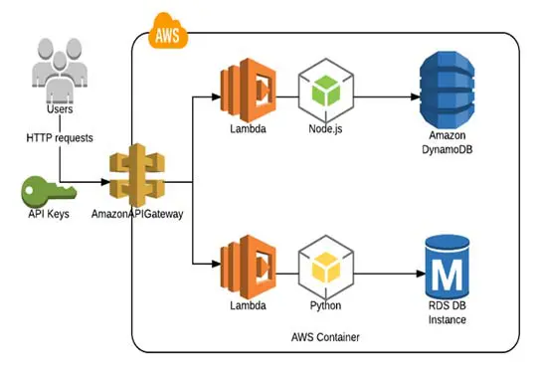
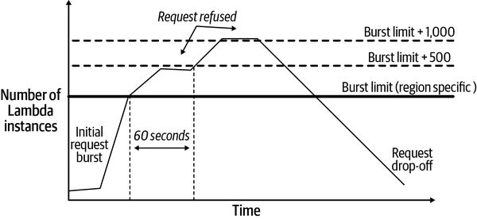
AWS Lambda
Expose Lambda Function as a HTTP endpoint
Map HTTP request to Lambda function
Notes:
As the number of concurrent requests for a function increases, Lambda will deploy more runtime instances to scale the processing.
If the request load continues to grow, Lambda reuses available instances and creates new instances as needed.
Eventually, when the request load falls, Lambda scales down by stopping unused instances. That’s the simple version, anyway. In reality, it is more complicated.
All Lambda functions have a built-in concurrency limit for request bursts. Interestingly, this default burst limit varies depending on the AWS region where the function is deployed. For example, in US West (Oregon), a function can scale up to 3,000 instances to handle a burst of requests, whereas in Europe (Frankfurt) the limit is 1,000 instances.

Slide 18
Experimental Results
How much does programming language effect performance and costs?
Google app engine server
Same API
Same database model and operations (Google Datastore)
Same client and test load
Same B1 instances, default autoscaling settings
4 server implementations
Go
Java
Python
Node.js
Notes:
- 80%write (POST) and 20% (GET)
- Behind the scenes code for all languages wrote to a NoSQL DB.

Slide 19
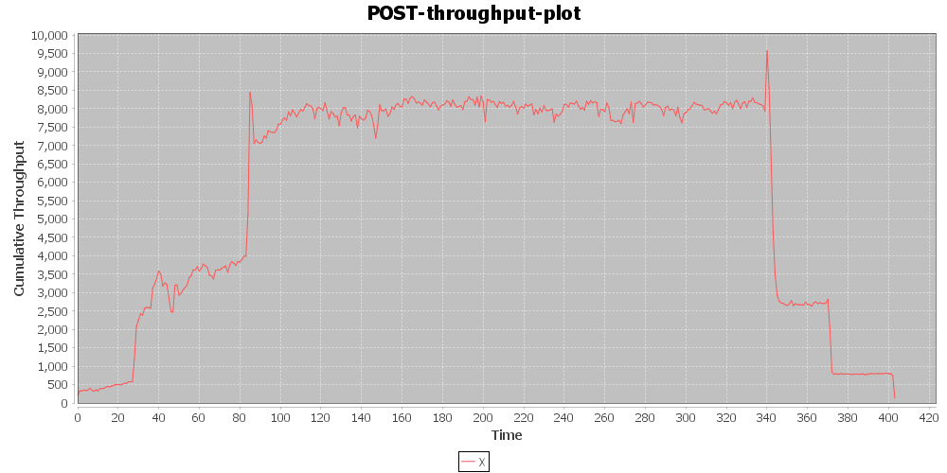
Experimental Results
Typical Load Test Profile
Notes:
64 – 1024 clients over an iteration of 400 seconds

Slide 20
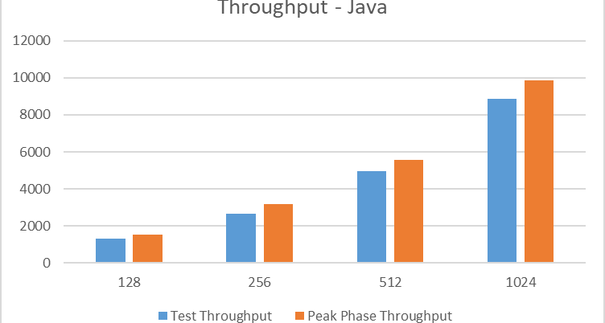
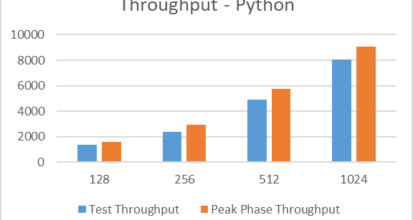
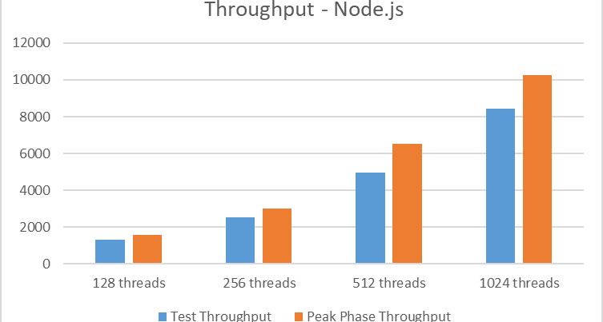
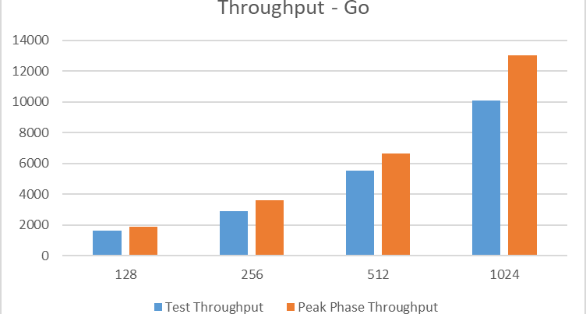
Experimental Results

Slide 21
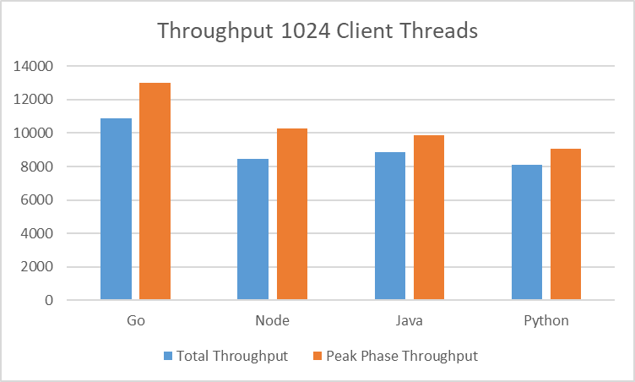
Experimental Results

Slide 22
Experimental Results
Language Cost Comparison

Slide 23
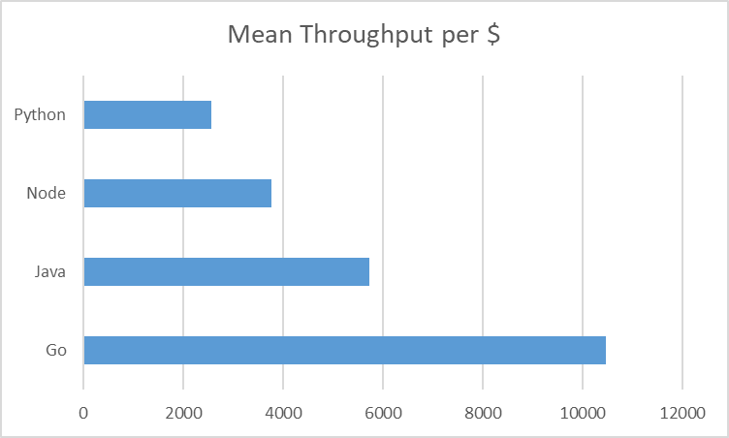
Experimental Results
Price Performance Ratio

Slide 24
Experimental Results
Autoscaling Parameters Experiment
parameter | default
target_cpu_utilization | 0.6
target_throughput_utilization | 0.6
max_concurrent_requests | 10

Slide 25
Experimental Results
Study Design with Go Server
Metric? | maxc10 | maxc35 | maxc65 | maxc90
CPU60
CPU70
CPU80

Slide 26
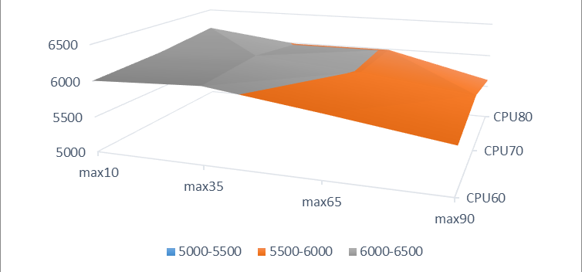
Experimental Results
Mean Throughput
Notes:
Response surface

Slide 27
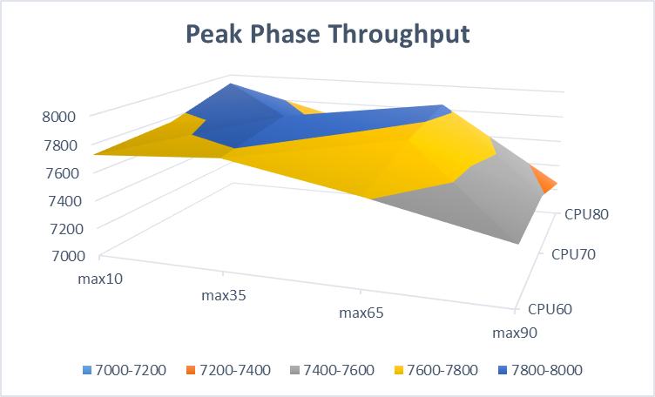
Experimental Results

Slide 28
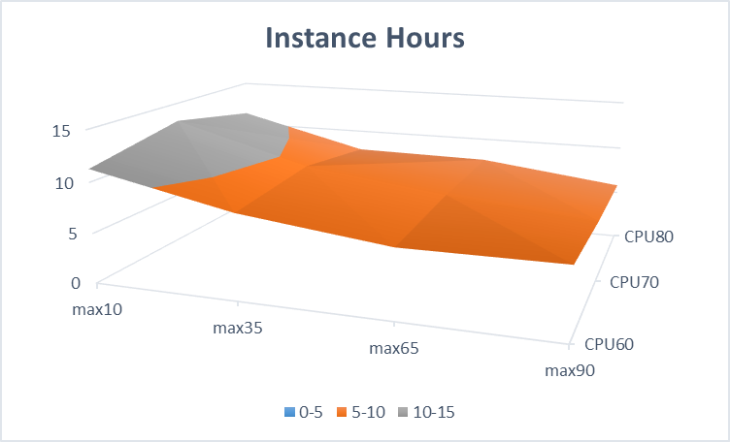
Experimental Results

Slide 29
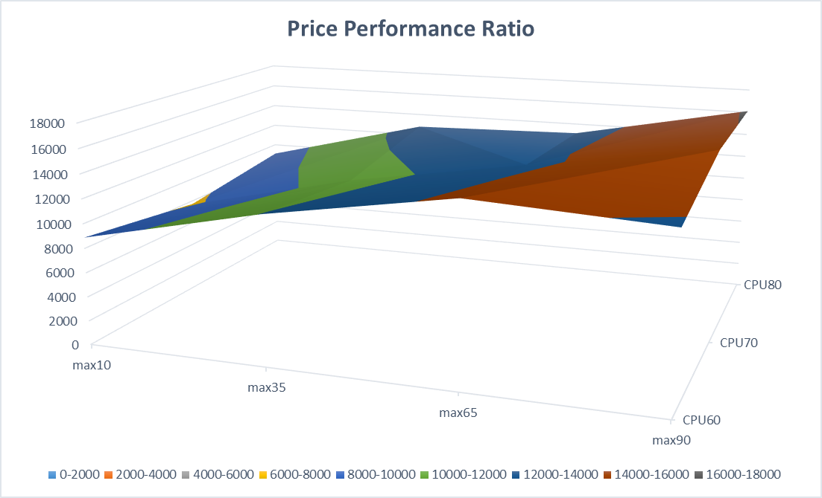
Experimental Results

Slide 30
Experimental Results
Some Takeaways
Higher performance possible at ~20% cheaper than default setting
Can achieve ~96% of default configuration performance at ~54% of default configuration costs
throuhput mean | max10 | max35 | max65 | max90
CPU60 | 6006 | 6067 | 5860 | 5636
CPU70 | 6064 | 6121 | 5993 | 5793
CPU80 | 6178 | 5988 | 5989 | 5605
instance hours | max10 | max35 | max65 | max90
CPU60 | 11 | 8 | 7 | 7
CPU70 | 13 | 9 | 7 | 6
CPU80 | 11 | 8 | 8 | 6
Notes:
Higher perf: max10-cpu60 , max35-cpu70
96% of default – max10-cpu60 (instance hours) – max90-cpu70

Slide 31
Summary
Serverless platforms available for all major cloud providers
Aim to make deployment and management ‘admin free’
Examples GAE and AWS Lambda
Different features and scaling approaches

Slide 32
Questions?

